Slide 1
Lecture 5: Control Statements – Part III
Dr. Tsung-Wei Huang
Department of Electrical and Computer Engineering
University of Utah, Salt Lake City, UT
Notes:
Morning everyone
Today we are looking into control flow in C++.

Slide 2
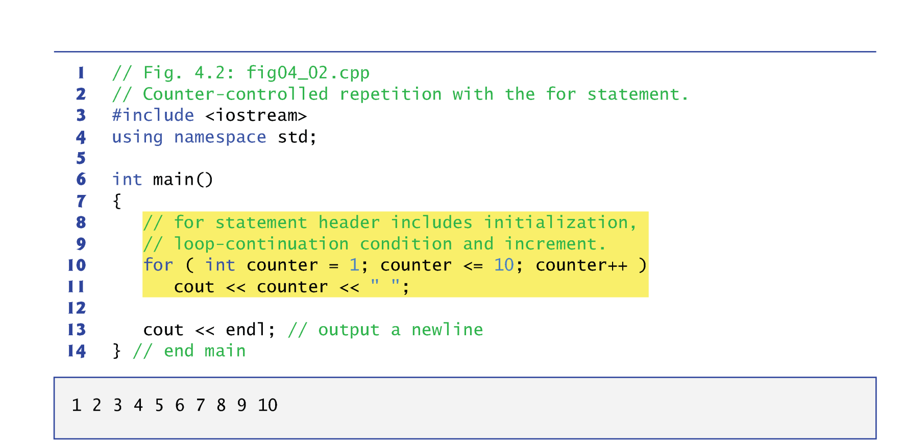
for Repetition Statement Example

Slide 3
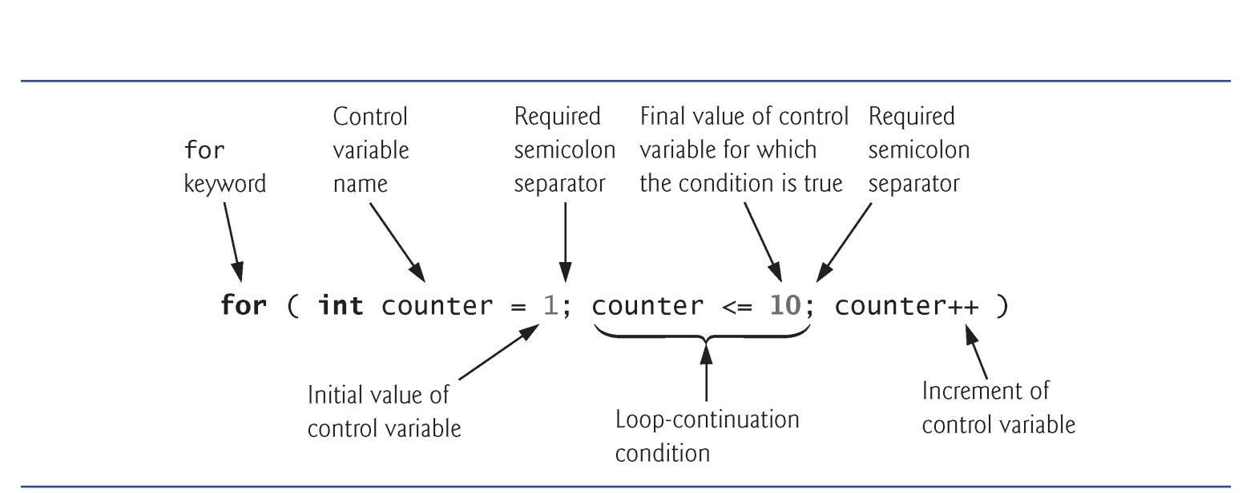
for Repetition Statement

Slide 4
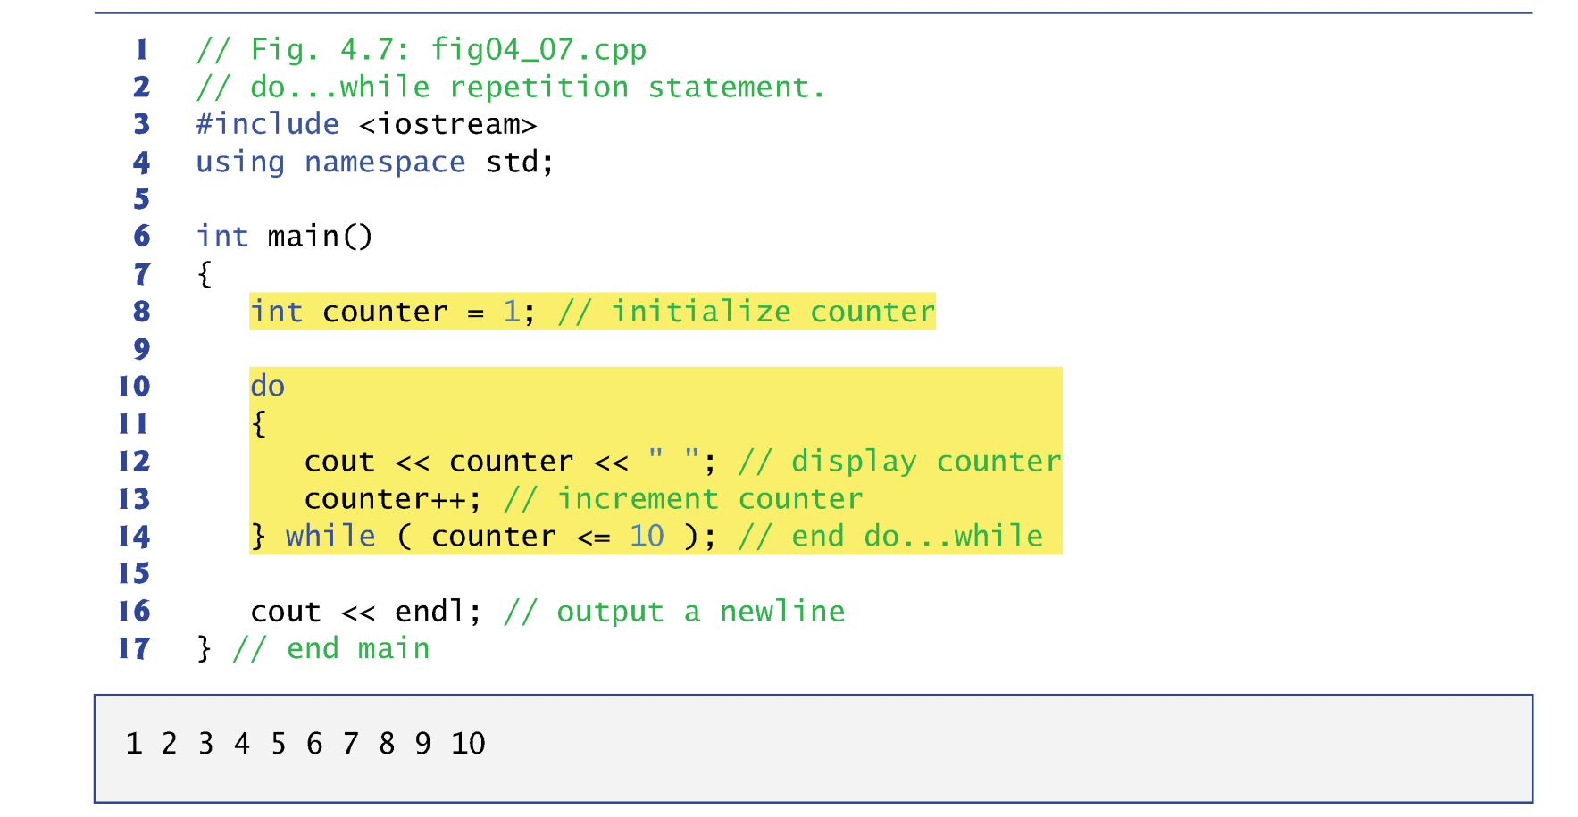
do…while Repetition Statement

Slide 5
switch Multiple-Selection Statement
The switch multiple-selection statement performs many different actions based on the possible values of a variable or expression.
Each action is associated with the value of a constant integral expression
i.e., any combination of character and integer constants that evaluates to a constant integer value.

Slide 6
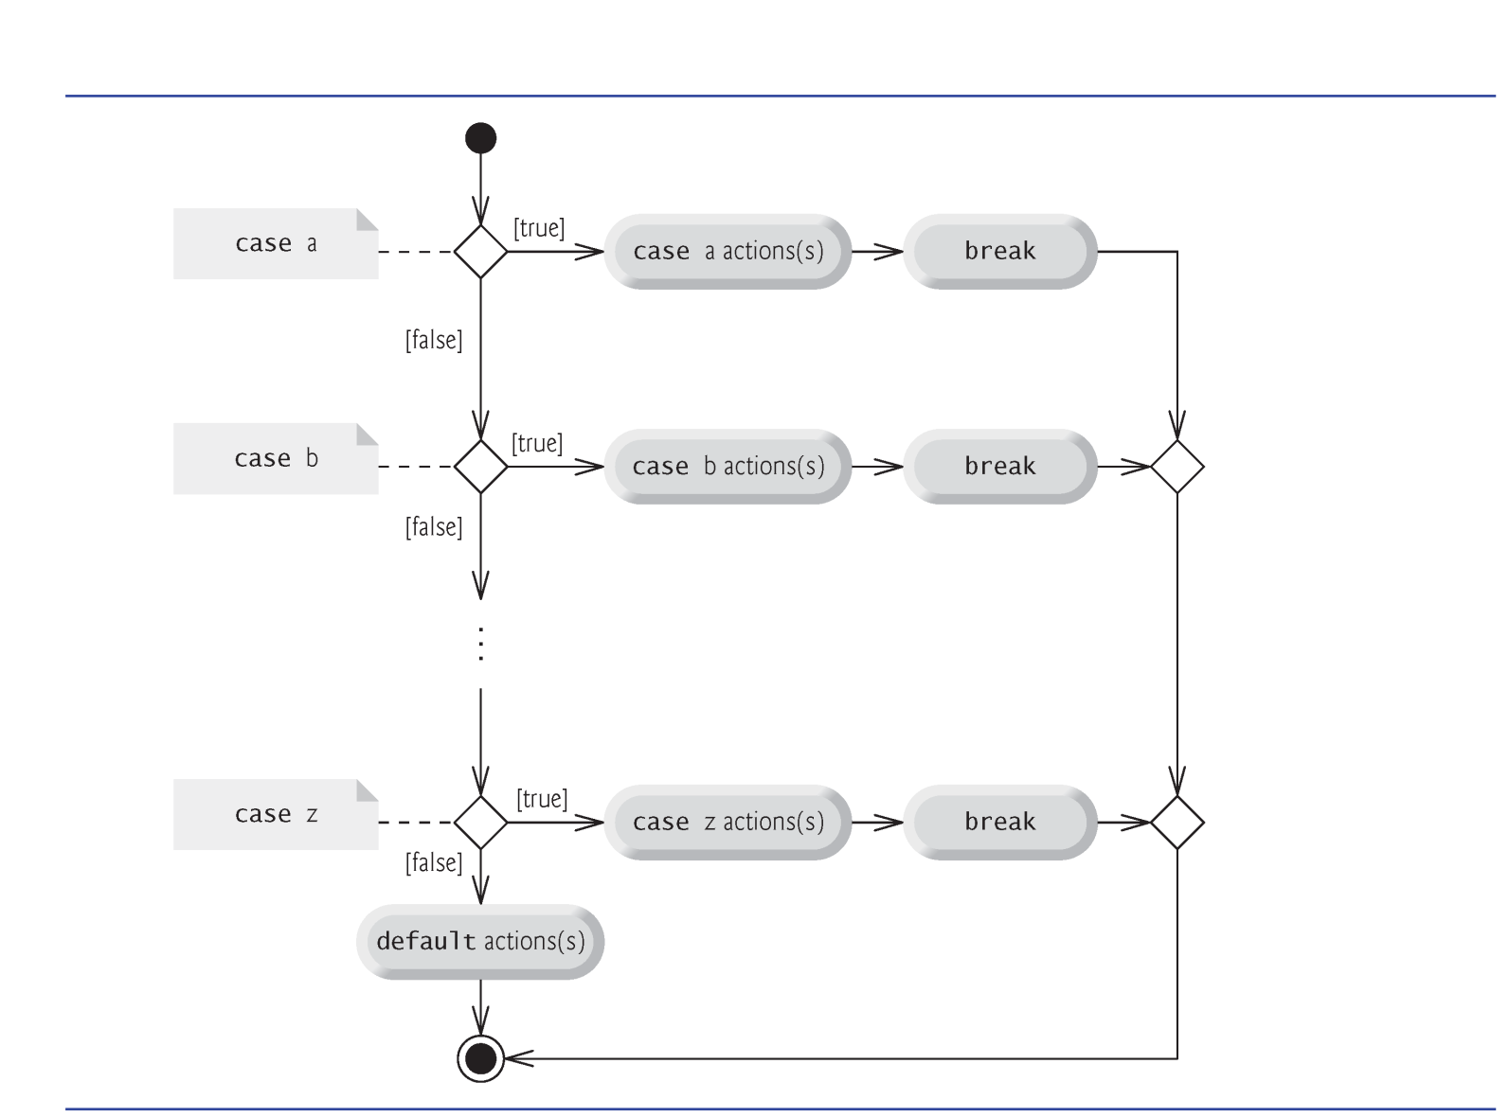
switch Multiple-Selection Statement

Slide 7
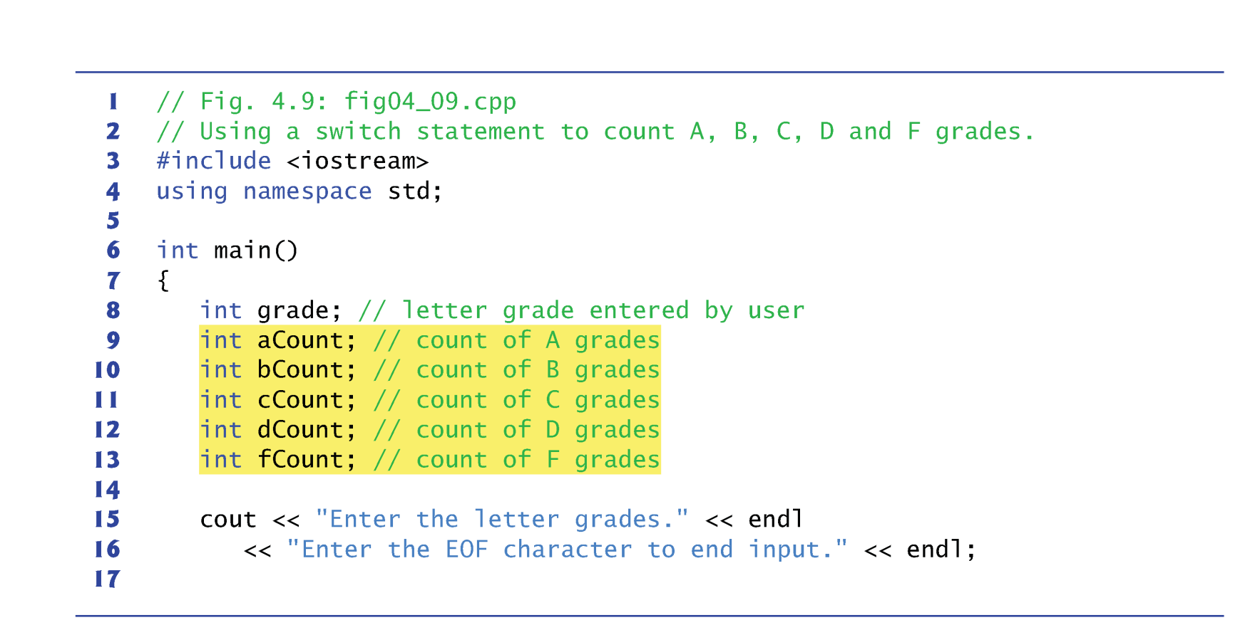
switch Multiple-Selection Statement

Slide 8
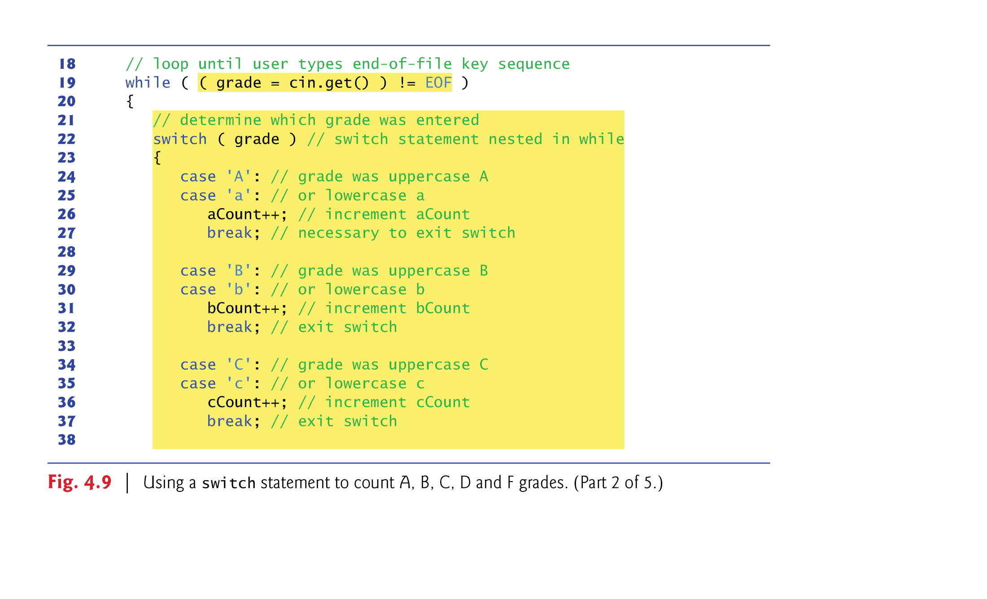
switch Multiple-Selection Statement

Slide 9
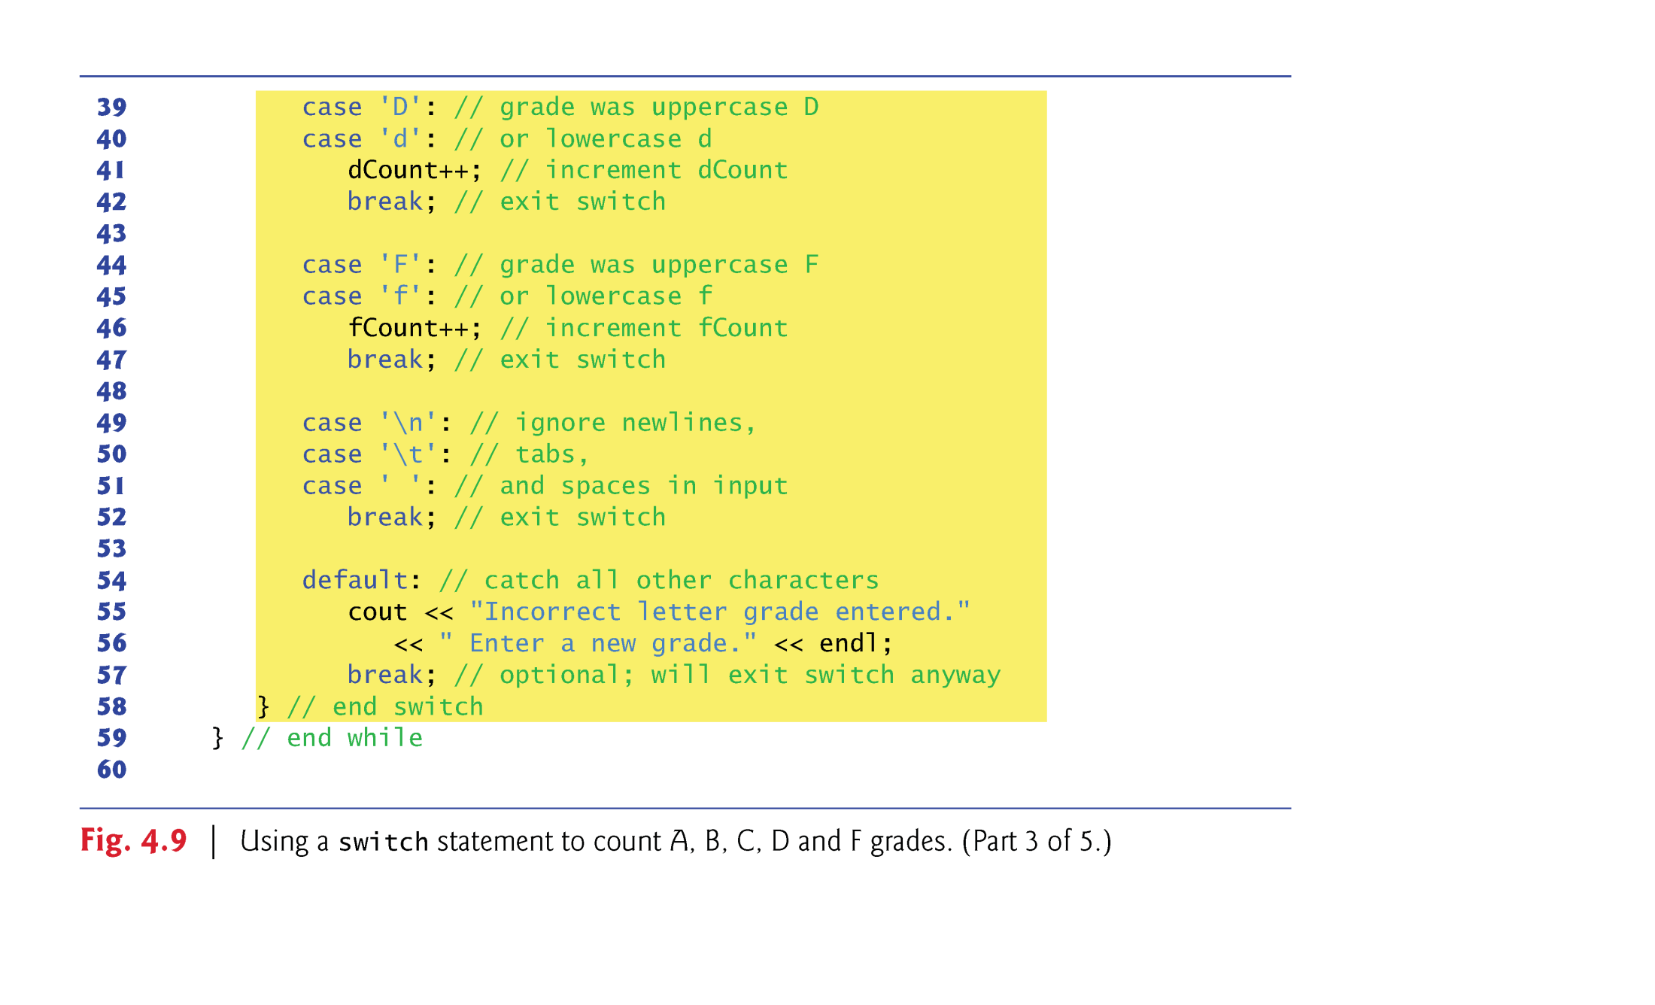
switch Multiple-Selection Statement

Slide 10
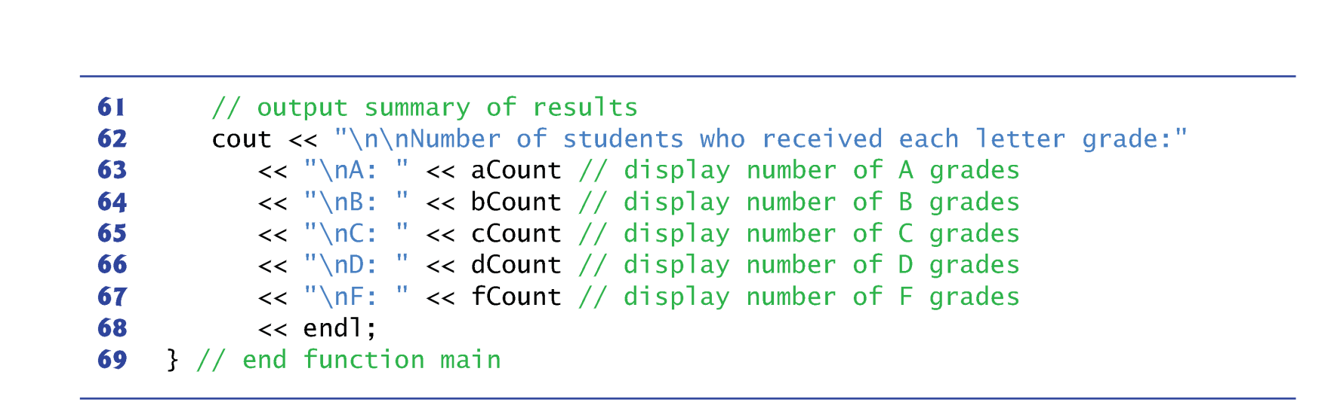
switch Multiple-Selection Statement

Slide 11
switch Multiple-Selection Statement
The switch statement consists of a series of case labels and an optional default case.
The switch statement compares the value of the controlling expression with each case label.
If a match occurs, the program executes the statements for that case.
Listing cases consecutively with no statements between them enables the cases to perform the same set of statements.
The break statement causes program control to proceed with the first statement after the switch.

Slide 12
switch Multiple-Selection Statement
Each case can have multiple statements.
The switch selection statement does not require braces around multiple statements in each case.
Without break statements, the statements for that case and subsequent cases are all executed when a match occurs
Until a break statement or the end of the switch is encountered.
Referred to as “falling through” to the subsequent cases.
If no match occurs between the controlling expression’s value and a case label, the default case executes.
If a switch statement does not contain a default case, program control continues with the first statement after the switch when no match occurs

Slide 13
switch Multiple-Selection Statement
The cin.get() function reads one character from the keyboard.
A character is stored as a “number” in the computer according to its ASCII code.
Normally, characters are stored in variables of type char; however, characters can be stored in any integer data type.
Can treat a character either as an integer or as a character, depending on its use. For example:
cout << "The character (" << 'a' << ") has the value " << static_cast< int > ( 'a' ) << endl;
prints the character a and its integer value as follows:
The character (a) has the value 97

Slide 14
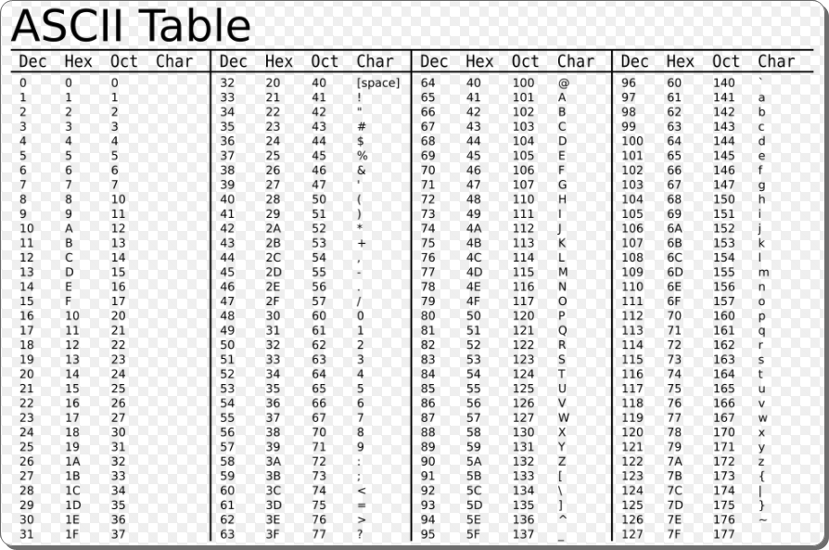
ASCII Code

Slide 15
ASCII Table
You cannot type the value –1 as the sentinel value. (ASCII code is 0~255)
EOF stands for “end-of-file”. Commonly used as a sentinel value for characters.
EOF is a symbolic integer constant defined in the <iostream> header file.
The EOF has type int
The keystroke combinations for entering end-of-file are system dependent.
Windows: Ctrl-Z ; UNIX: Ctrl-D

Slide 16
ASCII Code
To have the program read the characters, we must send them to the computer by pressing the Enter key.
This places a newline character in the input after the character we wish to process.
Often, this newline character must be specially processed.
The cin.get() function can ignore the newline character automatically
Some functions can do this, but some functions cannot.

Slide 17
break and continue statements
The break statement, when executed in a while, for, do…while or switch statement, causes immediate exit from that statement.
Program execution continues with the next statement.
Common uses of the break statement are to escape early from a loop or to skip the remainder of a switch statement.

Slide 18
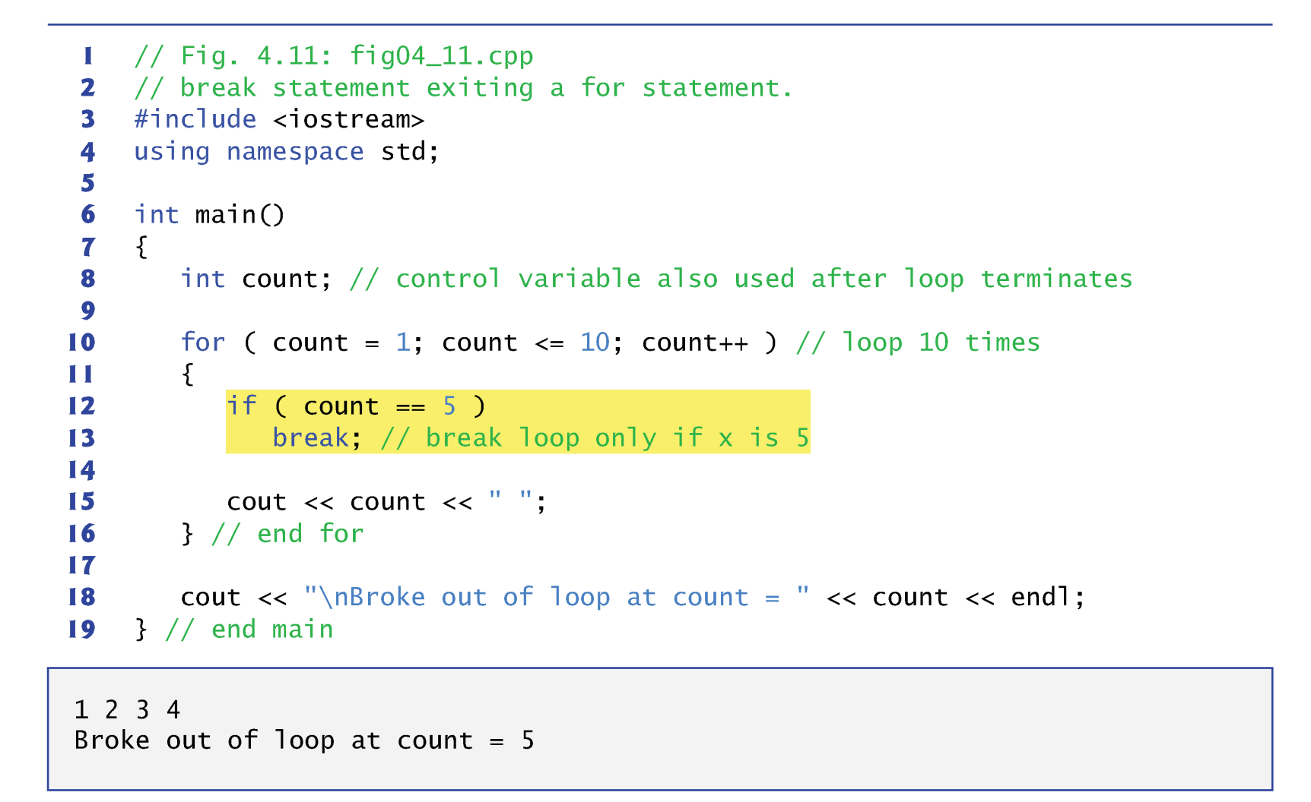
break and continue statements

Slide 19
break and continue statements
The continue statement skips the remaining statements in its body and proceeds with the next iteration of the loop.
When executed in a while, for or do…while statement
In while and do…while statements, the loop-continuation test evaluates immediately after the continue statement executes.
In the for statement, the increment expression executes, then the loop-continuation test evaluates.

Slide 20
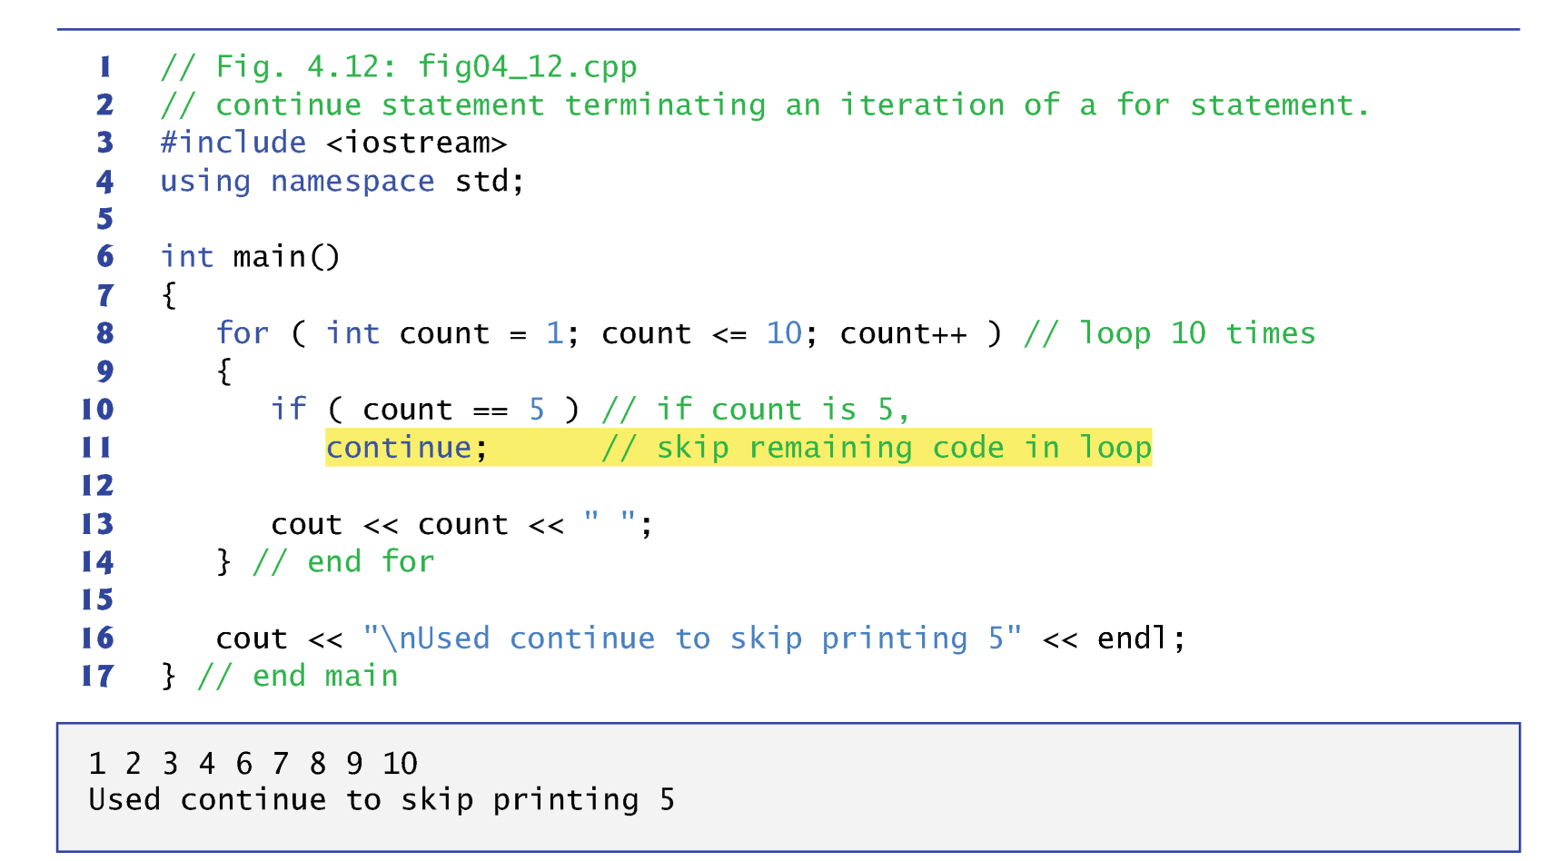
break and continue statements

Slide 21
Break & Continue Scope of Effect
In nested loops, break/continue can only affect the most inner loop where the break/continue stands
for (i=1; i<=5; i++)
{ for (j=1; j<=3; j++)
{
printf(“(%d,%d) “,i,j);
if (i==3) break;
}
printf(“\n”);
}
If break is used to skip
the following switch
statements, it has no
effects on the outside loop
One-time use only
break inner
loop j only
(1,1) (1,2) (1,3)
(2,1) (2,2) (2,3)
(3,1)
(4,1) (4,2) (4,3)
(5,1) (5,2) (5,3)
Jump out the inner loop
and start from here

Slide 22
Usage in Infinite Loop
Infinite loops are helpful when the termination condition is generated inside the loop
while (1) {
......
ans = a * b;
if (ans == 0) break;
......
}
Should be used with break to terminate the loop
Make sure the condition will eventually become TRUE
If sentinel-controlled loop can be used instead, use it !!
Infinite loops are not easy to debug
1 (non-zero value)
means always TRUE

Slide 23
Logical Operators
C++ provides logical operators that are used to form more complex conditions by combining simple conditions.
&& (logical AND)
|| (logical OR)
! (logical NOT, also called logical negation).

Slide 24
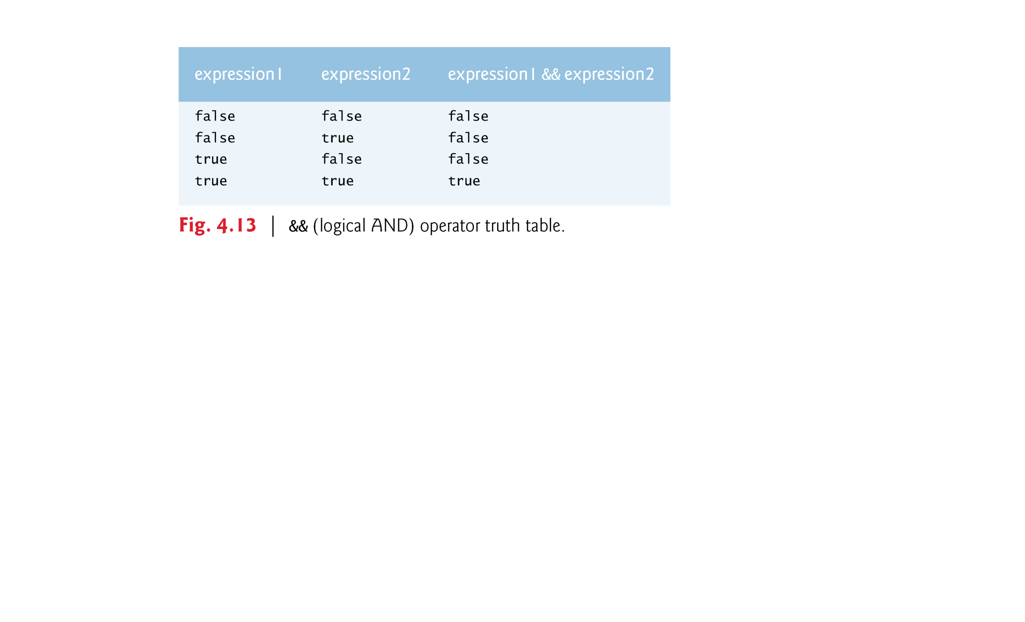

Logical Operators
AND Operator &&
OR Operator ||

Slide 25
Summary
while loop statement
do...while loop statement
for loop statement
switch statement
continue and break

Slide 26
LAB 4
Sign up your attendance here: https://docs.google.com/spreadsheets/d/1-UcFXgP9A3SDcwU_f5XxV68YFjVbHQeYIMI3m8mGtkI/edit#gid=0 Mark ‘Y’
Work in a group to solve three programs
100 minutes to work
Select one person to present
Instructor will randomly decide which problem to present your solution

Slide 27
Practice 1
Write a program that prints all multiples of 3
Version 1: for loop + continue
Version 2: while loop + break
Input: N
Output: multiples of 3 in the range [1, n]
Example
N=10 => output: 3, 6, 9
N=17 => output: 3, 6, 9, 12, 15

Slide 28
Practice 2: 3n+1
Consider the following two operations on an arbitrary positive integer:
If the number is even, divide it by two.
If the number is odd, triple it and add one.
The Collatz conjecture is: This process will eventually reach the number 1, regardless of which positive integer is chosen initially.
Write a program that takes an input N and then prints your progress of 3n+1. For example, when N=12, your program prints 12, 6, 3, 10, 5, 16, 8, 4, 2, 1.

Slide 29
Practice 3
Input: N
Output
If N is larger than 10 and N is an even number
Print ”N is an even number larger than 10”
If N is larger than 10 and N is an odd number
Print “N is an odd number larger than 10”
If N is smaller than or equal to 10, and is even
Print “N is an even number <= 10”
If N is smaller than or equal to 10, and is odd
Print “N is an odd number <= 10”

